Slide 1
Agenda of Lecture 8,9,10
Topics to Be Covered:
Structure of os( revision)
System call (revision)
Process
PCB

Slide 2
Structure of os (revision)
Simple Structure
Layered Approach
Microkernel
Modules

Slide 3
Simple Structure (revision)
It was written to provide the most functionality in the least space, so it was not carefully divided into modules
In MS-DOS, the interfaces and levels of functionality are not well separated

Slide 4
Layered Approach (revision)
In this the operating system is broken into a number of layers (levels). The bottom layer (layer 0) is the hardware; the highest (layer N) is the user interface
The main advantage of the layered approach is simplicity of construction and debugging
The disadvantage with it is deﬁning the various layers Because a layer can use only lower-level layers, careful planning is necessary

Slide 5
Microkernel (revision)
This method structures the operating system by removing all nonessential components from the kernel and implementing them as system and user-level programs. The result is a smaller kernel.
One advantage of the microkernel approach is that it makes extending the operating system easier
All new services are added to user space and consequently do not require modiﬁcation of the kernel.

Slide 6
Modules (revision)
the best current methodology for operating-system design involves using loadable kernel modules.
Here, the kernel has a set of core components and links in additional services via modules, either at boot time or during run time.
This type of design is common in modern implementations of UNIX, such as Solaris, Linux, and Mac OS X, as well as Windows.
The idea of the design is for the kernel to provide core services while other services are implemented dynamically, as the kernel is running.

Slide 7
System Call (revision)
System calls provide an interface between the process and the operating system.
System calls allow user-level processes to request some services from the operating system which process itself is not allowed to do.

Slide 8
System Call(revision)
The following different types of system calls provided by an operating system:
Process control
File management
Device management
Information maintenance
Communications

Slide 9
Process Concept
Batch system – jobs
Time-shared systems – user programs or tasks
Textbook uses the terms job and process almost interchangeably
Process – a program in execution; process execution must progress in sequential fashion
Multiple parts
The program code, also called text section
Current activity including program counter, processor registers
Stack containing temporary data
Function parameters, return addresses, local variables
Data section containing global variables
Heap containing memory dynamically allocated during run time

Slide 10
Process Concept (Cont.)
active
Program becomes process when executable file loaded into memory
Execution of program started via GUI mouse clicks, command line entry of its name, etc
One program can be several processes
Consider multiple users executing the same program

Slide 11
Program v/s Process

Slide 13
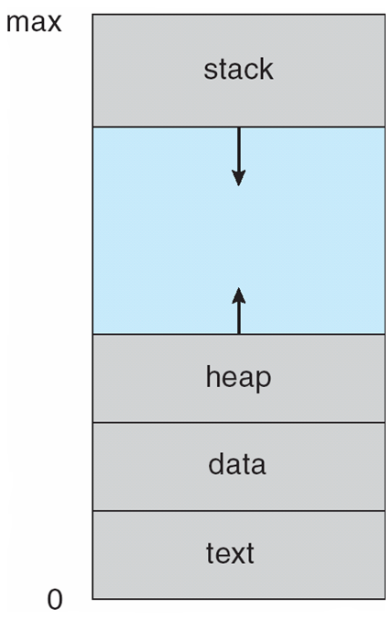
Process in Memory

Slide 14
Process State
As a process executes, it changes state
new: The process is being created
running: Instructions are being executed
waiting: The process is waiting for some event to occur
ready: The process is waiting to be assigned to a processor
terminated: The process has finished execution

Slide 15
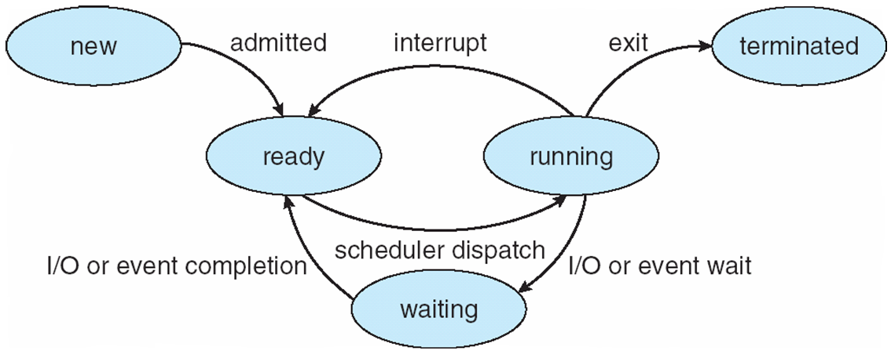
Diagram of Process State

Slide 16
Process Control Block (PCB)
(also called task control block)
Process state – running, waiting, etc
Program counter – location of instruction to next execute
CPU registers – contents of all process-centric registers
CPU scheduling information- priorities, scheduling queue pointers
Memory-management information – memory allocated to the process
Accounting information – CPU used, clock time elapsed since start, time limits
I/O status information – I/O devices allocated to process, list of open files

Slide 17
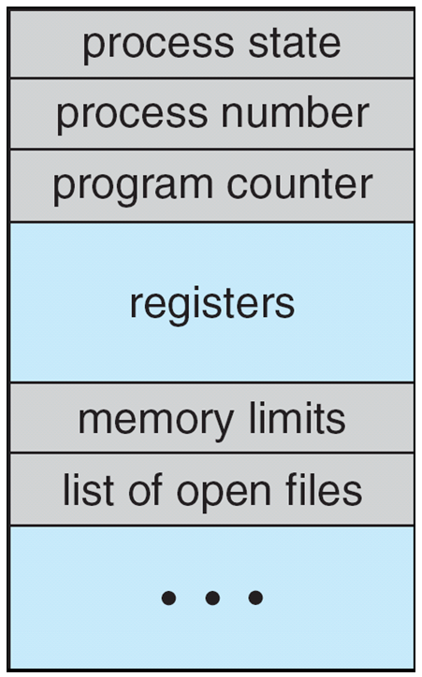
Process Control Block (PCB)

Slide 18
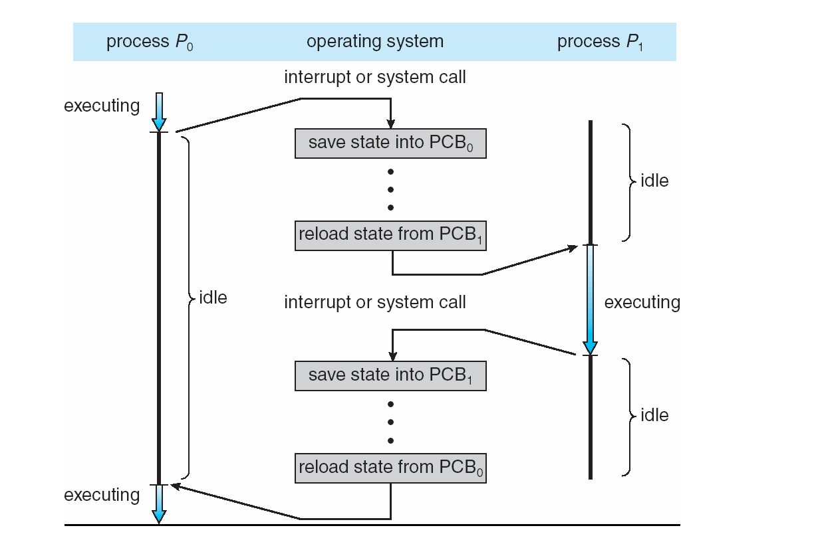
CPU Switch From Process to Process

Slide 19
Process Scheduling
Maximize CPU use, quickly switch processes onto CPU for time sharing
Process scheduler selects among available processes for next execution on CPU
Maintains scheduling queues of processes
Job queue – set of all processes in the system
Ready queue – set of all processes residing in main memory, ready and waiting to execute
Device queues – set of processes waiting for an I/O device
Processes migrate among the various queues

Slide 20
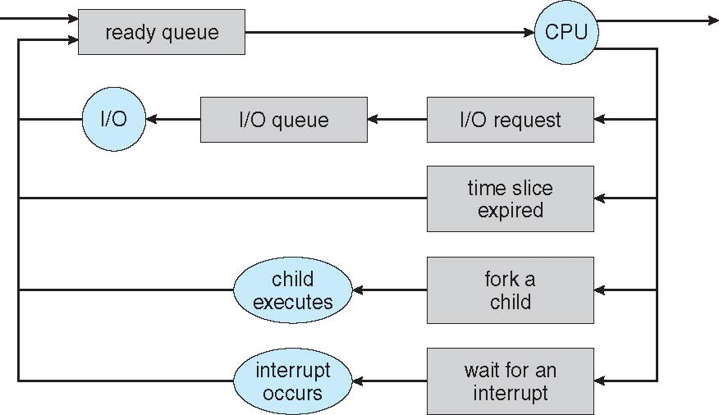
Representation of Process Scheduling
Queueing diagram represents queues, resources, flows

Slide 21
Schedulers
Short-term scheduler (or CPU scheduler) – selects which process should be executed next and allocates CPU
Sometimes the only scheduler in a system
Short-term scheduler is invoked frequently (milliseconds) ⇒ (must be fast)
Long-term scheduler (or job scheduler) – selects which processes should be brought into the ready queue
Long-term scheduler is invoked infrequently (seconds, minutes) ⇒ (may be slow)
The long-term scheduler controls the degree of multiprogramming
Processes can be described as either:
I/O-bound process – spends more time doing I/O than computations, many short CPU bursts
CPU-bound process – spends more time doing computations; few very long CPU bursts
Long-term scheduler strives for good process mix

Slide 22
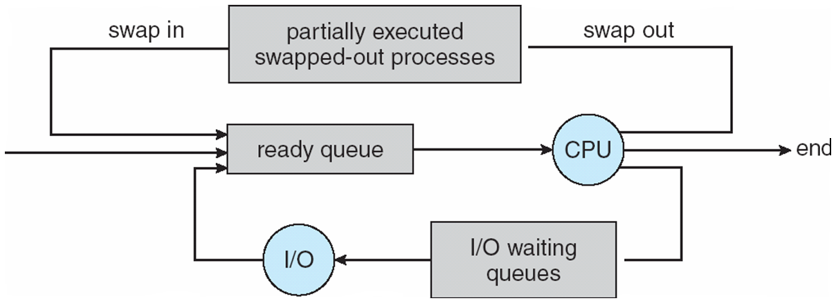
Addition of Medium Term Scheduling
Medium-term scheduler can be added if degree of multiple programming needs to decrease
Remove process from memory, store on disk, bring back in from disk to continue execution: swapping

Slide 23
Context Switch
When CPU switches to another process, the system must save the state of the old process and load the saved state for the new process via a context switch
Context of a process represented in the PCB
Context-switch time is overhead; the system does no useful work while switching
The more complex the OS and the PCB ➔ the longer the context switch
Time dependent on hardware support
Some hardware provides multiple sets of registers per CPU ➔ multiple contexts loaded at once

Slide 24
Operations on Processes
System must provide mechanisms for:
process creation,
process termination,
and so on as detailed next

Slide 25
Process Creation
Parent process create children processes, which, in turn create other processes, forming a tree of processes
Generally, process identified and managed via a process identifier (pid)
Resource sharing options
Parent and children share all resources
Children share subset of parent’s resources
Parent and child share no resources
Execution options
Parent and children execute concurrently
Parent waits until children terminate

Slide 26
A Tree of Processes in Linux

Slide 27
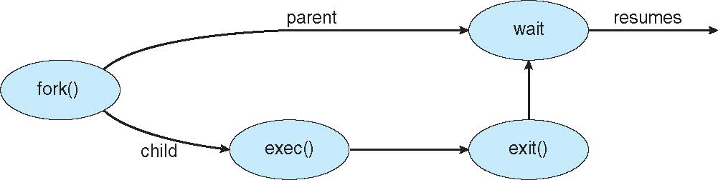
Process Creation (Cont.)
Address space
Child duplicate of parent
Child has a program loaded into it
UNIX examples
fork() system call creates new process
exec() system call used after a fork() to replace the process’ memory space with a new program

Slide 28
Process Termination
Process executes last statement and then asks the operating system to delete it using the exit() system call.
Returns status data from child to parent (via wait())
Process’ resources are deallocated by operating system
Parent may terminate the execution of children processes using the abort() system call. Some reasons for doing so:
Child has exceeded allocated resources
Task assigned to child is no longer required
The parent is exiting and the operating systems does not allow a child to continue if its parent terminates

Slide 29
Process Termination
Some operating systems do not allow child to exists if its parent has terminated. If a process terminates, then all its children must also be terminated.
cascading termination. All children, grandchildren, etc. are terminated.
The termination is initiated by the operating system.
The parent process may wait for termination of a child process by using the wait()system call. The call returns status information and the pid of the terminated process
pid = wait(&status);
If no parent waiting (did not invoke wait()) process is a zombie
If parent terminated without invoking wait , process is an orphan

Slide 30
Questions
Q1.Explain the various states of the process using suitable diagram. (RTU-2013)
Q.2 What is a process? What is the difference between a program and a process? Explain PCB using a suitable example.
Q.3 What is the main difference between monolithic and microkernel architecture?
Q.4 Explain the difference between microkernel and macro kernel?
Q.5 What is the main advantage of the layered approach to system design?
Q.6 What is the purpose of system calls?

